Slide 1
Linear Regression

Slide 2
Classification: It predicts the class of the dataset based on the independent input variable. Class is the categorical or discrete values. like the image of an animal is a cat or dog?
Regression: It predicts the continuous output variables based on the independent input variable. like the prediction of house prices based on different parameters like house age, distance from the main road, location, area, etc.
Regression searches for relationships among variables.

Slide 3
Linear Regression
Linear regression is a type of supervised machine learning algorithm that computes the linear relationship between a dependent variable and one or more independent features.
When the number of the independent feature, is 1 then it is known as Univariate Linear regression, and in the case of more than one feature, it is known as multivariate linear regression.

Slide 4
Linear Regression
The goal of the algorithm is to find the best linear equation that can predict the value of the dependent variable based on the independent variables.
The equation provides a straight line that represents the relationship between the dependent and independent variables.
The slope of the line indicates how much the dependent variable changes for a unit change in the independent variable(s).

Slide 5
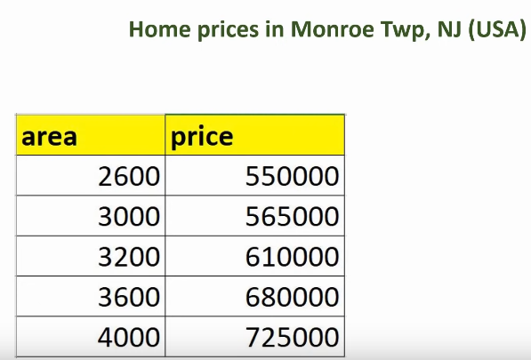
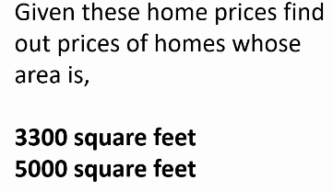

Slide 6
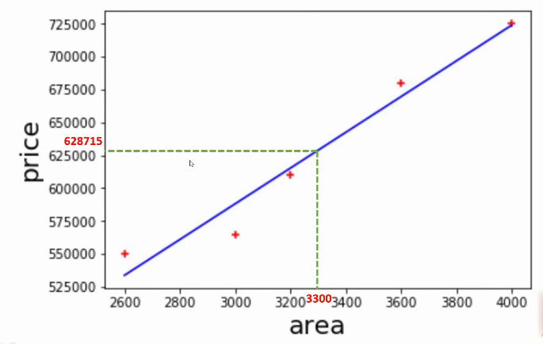

Slide 7
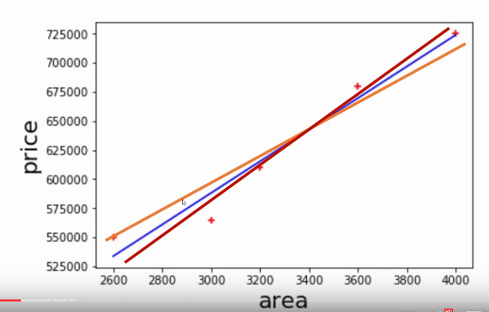
Linear Regresion

Slide 8
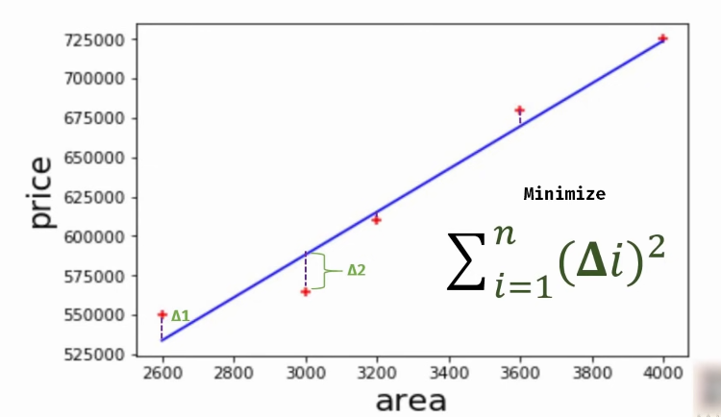

Slide 9
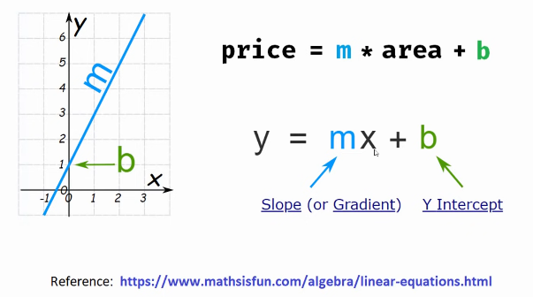

Slide 10
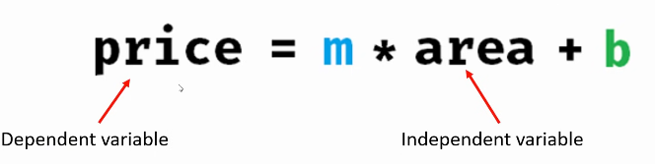
Linear Regression(Single Variable)

Slide 11
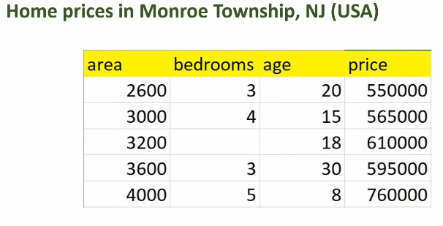
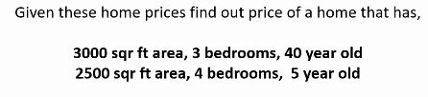
Linear Regression(Multiple Variables)

Slide 12
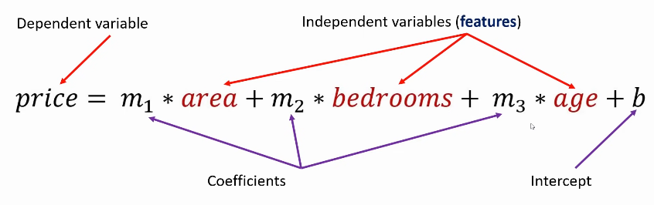

Linear Regression(Multiple Variables)

Slide 13
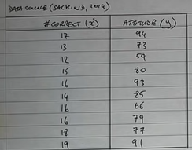
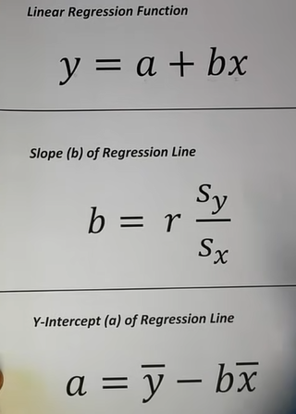
Example

Slide 14
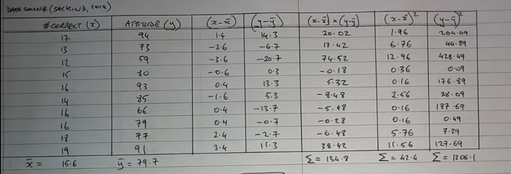
Example

Slide 15
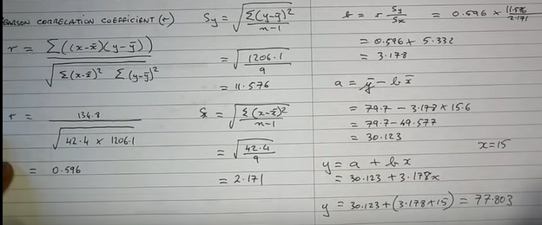
Example

Slide 16
Applications
Risk Assessment For Insurance
The Impact Of A Supplement On Weight Loss
Gauging The Impact Of Advertising On Sales
Economic studies
The amount of water vs the height of a plant
Finding the connection between cool drink sales and temperature
The linear connection between water bill and amount of water used
The connection between carbon emissions and average temperature
Work experience vs salary
The connection between meat consumption and obesity

Slide 17
Advantages vs Disadvantages
Advantages | Disadvantages
Linear regression performs exceptionally well for linearly separable data | The assumption of linearity between dependent and independent variables
Easier to implement, interpret and efficient to train | It is often quite prone to noise and overfitting
It handles overfitting pretty well using dimensionally reduction techniques, regularization, and cross-validation | Linear regression is quite sensitive to outliers
One more advantage is the extrapolation beyond a specific data set | It is prone to multicollinearity
Multicollinearity is a statistical concept where several independent variables in a model are correlated. Two variables are considered perfectly collinear if their correlation coefficient is +/- 1.0. Multicollinearity among independent variables will result in less reliable statistical inferences.

Slide 18
Reference
https://www.youtube.com/watch?v=8jazNUpO3lQ&list=PLeo1K3hjS3uvCeTYTeyfe0-rN5r8zn9rw&index=2
https://www.youtube.com/watch?v=J_LnPL3Qg70&list=PLeo1K3hjS3uvCeTYTeyfe0-rN5r8zn9rw&index=3
https://www.youtube.com/watch?v=PPLop4L2eGk&list=PLLssT5z_DsK-h9vYZkQkYNWcItqhlRJLN

